Slide 1

MAT-1.2.1-T005-D001 EUROFER97 MPH development: Specifics of KIT contribution in 2016
WPMAT EDDI Monitoring Meeting
3-4 November 2016, Garching, Germany
Ermile Gaganidze (Author, KIT)

Slide 2

MAT-1.2.1-T005: PPPT Material Handbook 2016 (KIT)
Objectives:
Continue activities towards the development of the EUROFER97 MPH
Highlight and address shortfalls in 2015 EUROFER97 MPH, including identification of gaps in the data filtering and allowables calculations
Include additional allowables and properties to address known gaps and shortfalls in 2015 MPH version
Incorporate new EUROFER97 data from existing sources and from 2016 EDDI testing campaigns
Co-ordinate, with MTA, to arrange implementation, organizational, content and editorial changes to EUROFER97 MPH
Deliverable:
Summary overview report on EUROFER97 MPH developments for year 2016
Acceptance Criteria
The task shall be carried out along the lines defined in the technical specification above

Slide 3
EUROFER97 MPH
Subjects of the improvement
Consider new structure of the MPH i.e. re-grouping of the chapters into
physical properties
conventional time-independent mechanical properties (Tensile, Impact, Low Cycle Fatigue, …)
Fracture-mechanical properties (Fracture Toughness, Fatigue Crack Growth)
Conventional time dependent mechanical properties (Creep, Creep-fatigue)
2015 MPH version: as received values and aged values. Consider to separate the aged values in irradiated values and thermally aged values
Introduce figure enumeration
Fill the known gaps by calculation of the missing allowables (reduction of area, fatigue crack growth) and by incorporation the results from the RR tests

Slide 4
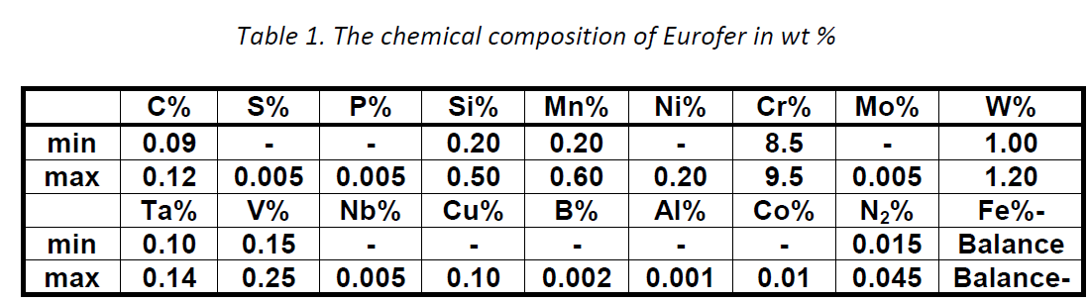
Chemical composition of EUROFER97
[1] F. Tavassoli: “Comparison of 316L(N) -IG and Eurofer for Early DEMO” EFDA-WP13-MAT-02-01
[2] A. Moeslang, E. Diegele, M. Klimiankou, R. Laesser, R. Lindau, E. Lucon, et al., Nucl. Fusion 45 (2005) 649-655

Slide 5
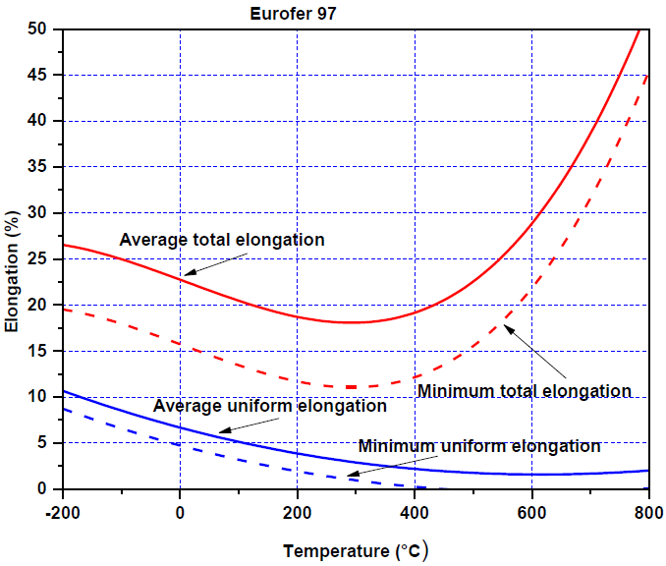





Uniform Elongation Average and minimum properties
ITER SDC-IC methodology
2012 Afcen RCC-MRx Code
$σ$ =0.9924% for the whole dataset
$${UE}_{min}\left(RT\right)={UE}_{av}\left(RT\right)−1.96σ(RT)$$
$${UE}_{min}\left(θ\right)={UE}_{av}\left(θ\right)−1.96σ$$
$${UE}_{av}\left(RT\right)=5.862\%; σ(RT)=1.038\%$$
$${UE}_{min }\left(θ\right)=\frac{{UE}_{min}\left(RT\right)}{{UE}_{av}\left(RT\right)}{UE}_{av}(θ)$$
Proposal: use RCC-MRx methodology
Notes:
L=28mm; d=3mm
Multiple rolling passes;

Slide 6
Total Elongation Irradiated values
Figure 2. Values of total elongation measured on differentially irradiated EUROFER97 in the function of the testing temperature
Condition, curve type | Temperature range | Equation
Unirradiated, average TE | -164 ≤ T ≤ 700°C | 22.75684-0.02355x-3.19787⋅10⁻⁶x² +9.89573⋅10⁻⁸x³
Unirradiated minimum TE (ITER SDC-IC) | -164 ≤ T ≤ 700°C | 22.75684-0.02355x-3.19787⋅10⁻⁶x² +9.89573⋅10⁻⁸x³-1.96⋅3.58
Dose <3 dpa; T_{irr}<350°C trend curve | -150 ≤ T ≤ 500°C | 14.41558-0.02209x+3.77228⋅10⁻⁵*x² +5.41726⋅10⁻⁸x³
Dose =4-6 dpa; T_{irr}<350°C trend curve | 325 ≤ T ≤ 330°C | 11.825
Dose =7-9 dpa; T_{irr}<350°C trend curve | 20 ≤ T ≤ 400°C | 11.4134-0.00214x
Dose =13-15 dpa; T_{irr}<350°C trend curve | 20 ≤ T ≤ 350°C | 9.77174+0.00338x
Dose =16-18 dpa; T_{irr}≥350°C trend curve | 400 ≤ T ≤ 450°C | -106.3725+0.28975x
Dose =30-42 dpa; T_{irr}<350°C trend curve | 20 ≤ T ≤ 350°C | 11.55066-0.00184x
Dose =70-78 dpa; T_{irr}<350°C trend curve | 20 ≤ T ≤ 350°C | 11.11167-0.00449*x
Notes:
W10PF: 0.7µm powder + source of carbon (phenol formaldehyde resin)
W10G: 0.7µm powder + source of carbon (graphene)

Slide 7
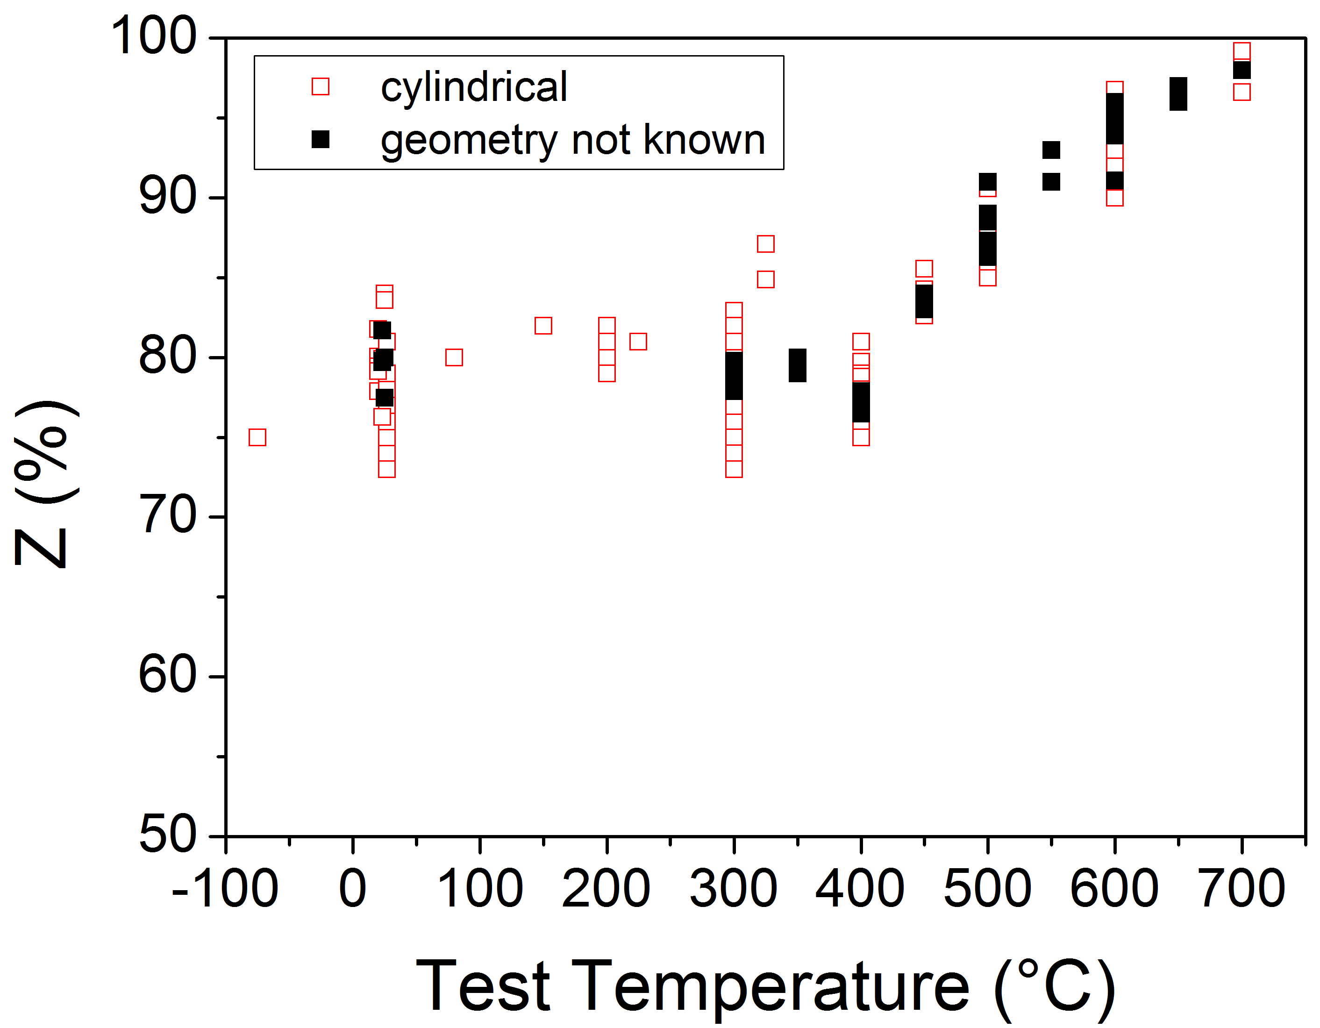
Reduction of Area Impact of specimen geometry
Material Identification | √
Specimen Identification Missing identification labels Missing specimen orientations Missing specimen geometries | Not full
Irradiation Condition | √
Test Missing test parameter (e.g. strain rate) Missing test environment | Not full
No clear influence of the specimen geometry within the available database
specimens with unidentified geometries also included in the analysis

Slide 8


Reduction of Area Average and minimum properties
Material Identification | √
Specimen Identification Missing identification labels Missing specimen orientations Missing specimen geometries | Not full
Irradiation Condition | √
Test Missing test parameter (e.g. strain rate) Missing test environment | Not full
3rd order polynomial fitting for determination of average curve
$$Z_{av}\left(T\right)=77.7929+0.0062T−3.482e−5T2+1.085e−7T3$$
ITER SDC-IC methodology for determination the minimum curve
$$Z_{min}\left(T\right)=Z_{av}\left(T\right)−1.96σ;$$
$σ=2.92$%

Slide 9
Reduction of area Irradiated values
Condition, curve type | Temperature range | Equation
Unirradiated, average Z | -150 ≤ T ≤ 700°C | 77.7929+0.0062*x-3.482e-5*x^2 +1.085e-7*x^3
Unirradiated minimum Z (ITER SDC-IC) | -150 ≤ T ≤ 700°C | 77.7929+0.0062*x-3.482e-5*x^2 +1.085e-7*x^3-1.96*2.92
Dose <3 dpa; T_{irr}=60°C trend curve | 20≤ T ≤ 500°C | 84.296+0.0035*x
Dose <3 dpa; T_{irr}=300°C trend curve | 20≤ T ≤ 400°C | 75.683+0.0324*x+4.1006e-6*x^2 -3.18e-7*x^3
Dose =7-9 dpa; T_{irr}<350°C trend curve | 20 ≤ T ≤ 400°C | 66.4584+0.1155*x-4.51e-4*x^2 +3.99e-7*x^3
Dose =13-15 dpa; T_{irr}<350°C trend curve | 20 ≤ T ≤ 300°C | 70.03-0.00748*x
Dose =16-18 dpa; T_{irr}≥350°C trend curve | 350 ≤ T ≤ 450°C | 28.845+0.107*x
Dose =30-42 dpa; T_{irr}<350°C trend curve | 20 ≤ T ≤ 350°C | 58.72035-0.00319*x
Dose =70-78 dpa; T_{irr}<350°C trend curve | 20 ≤ T ≤ 350°C | 66.52576-0.02379*x

Slide 10
Tensile strength Irradiated trend curves
Condition, curve type | Temperature range | Equation
Unirradiated, average Rm | -200 ≤ T ≤ 700°C | 671.31076-0.91828*x+0.00397*x^2-1.04272E-5*x^3+1.02617E-8*x^4-4.29924E-12*x^5
Unirradiated minimum Rm (RCC-MRx) | -200 ≤ T ≤ 700°C | (600/655.25149)*(671.31076-0.91828*x+0.00397*x^2-1.04272E-5*x^3+1.02617E-8*x^4-4.29924E-12*x^5)
Dose <3 dpa; T_{irr}<350°C trend curve | -200≤ T ≤ 500°C | 845.38626-1.03298*x+0.00209*x^2-2.52175E-6*x^3
Dose =7-9 dpa; T_{irr}<350°C trend curve | 20 ≤ T ≤ 400°C | 1086.91898-0.62961*x-4.19386E-4*x^2+1.20197E-6*x^3
Dose =13-15 dpa; T_{irr}<350°C trend curve | 20 ≤ T ≤ 300°C | 1030.08498-0.50957*x
Dose =16-18 dpa; T_{irr}≥350°C trend curve | 350 ≤ T ≤ 450°C | 7663.2325-33.62398*x+0.03906*x^2
Dose =30-42 dpa; T_{irr}<350°C trend curve | 20 ≤ T ≤ 350°C | 1170.52404-0.6751*x
Dose =70-78 dpa; T_{irr}<350°C trend curve | 20 ≤ T ≤ 350°C | 1250.91507-0.73317*x

Slide 11
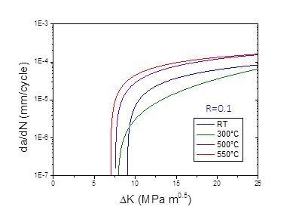
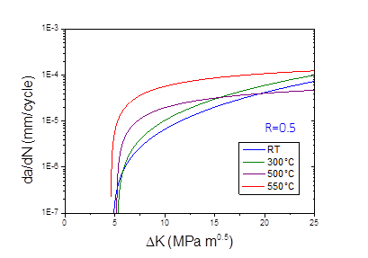
Fatigue Crack Growth EUROFER97, Heat E83697, 980°C/30min + 760°C/90min
Fatigue pre-cracking
Sinusoidal load, frequency 30 Hz
Electric potential method for crack advancement
K-Decreasing procedure
[1] ASTM E 647 – Standard Test Method for measurement of Fatigue Crack Growth rates
[2] J. Aktaa, M. Lerch, Journal of Nuclear Materials 353 (2006) 101,108

Slide 12
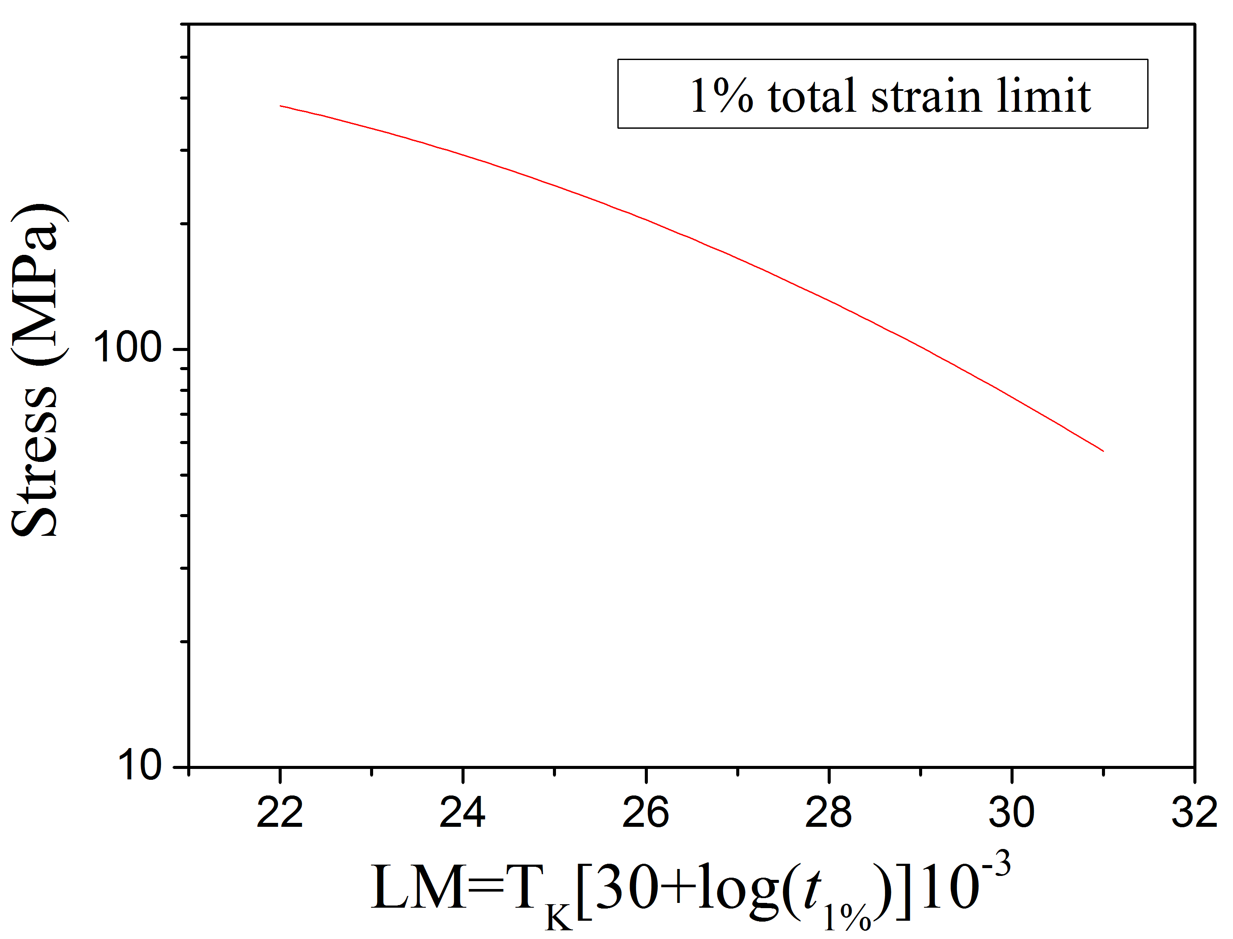
Thermal Creep
Afcen RCC-MRx methodology
S_{t} (T,t) defined as the least of
2/3 of the minimum stress corresponding to average creep rupture time t at T
80% of the minimum stress corresponding to time t and temperature T for onset of tertiary creep
3) Stress inducing total strain (elastic +plastic +creep) of 1%. This stress being derived from the tensile hardening rule and from the creep strain law. A minimum value equal to 0.8 times the average value.
Stresses inducing 1% total strain is determined experimentally from the original creep curves

Slide 13
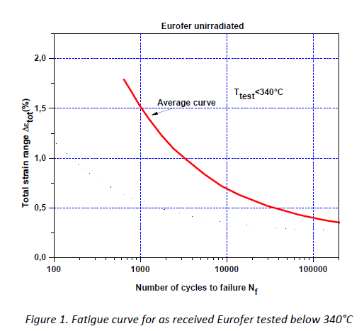
General remarks
Eliminate traces of removed data
Address open comments to EUROFER97 MPH 2015
Check language

Slide 14
Summary
A supporting document to the EUROFER97 MPH chapter has been prepared aiming at closing the known gaps by calculating the missing allowables
The shortcomings in the calculation of selected allowables in 2015 version have been eliminated
New allowables and trend curves are included for reduction of area, fatigue crack growth and Larsen-Miller diagram
Depending on the data availability the influence of the irradiation is given for some properties in addition

Slide 15
Midterm–Review: Objectives-Status for the 5 year period
Objective(s):
Propose Material Data Handling Agreement between EUROfusion and RUs for regulation of the access and manipulation of the material data
Panel review the existing data against the EDDI Database quality thresholds (2M9HTV) to identify data for inclusion and exclusion in MPH
Calculate allowables from qualified data by applying two differing calculation methodologies; Compare the allowables calculated by different RUs
Release of the first draft of EUROFER97 MPH in collaboration with MTA and CEA
Highlight and address shortfalls in 2015 draft EUROFER97 MPH
Include additional allowables and properties to address known gaps and shortfalls in 2015 draft EUROFER97 MPH
Achievement and status:
Report the achievements
Material Data Handling Agreement Proposal submitted to EUROfusion PMU
Panel review of the data against the EDDI Database quality thresholds
Application of AFCEN, ASME & ITER SDC-IC methodologies to calculate allowable
Population of MPH together with MTA with one set of calculated allowables
Identification and elimination of shortfalls in 2015 EUROFER97 MPH

Slide 16
Midterm–Review: Objectives-Status for the 5 year period
Achievement and status:
Report as well on failures (long-term as important as appearing all time “brilliant”)
Material Data Handling Agreement not passed
Round Robin Testing results delayed
How far are you wrt to schedule: Activity in line wrt the schedule
Impact on the project
Reference document on EUROFER97 for EDDI-DDC activities
Interaction with other tasks/work-packages ….
Reference document on EUROFER97 for WP-BB and WP-DIV
Outlook:
Next steps ahead
Adapt MPH structure to EDDI-DDC
Develop 1st draft on tungsten MPH
Challenge
Access to the raw tungsten data produced outside EUROfusion MAT project
…

Slide 17























